Slide 1


TechRadar
THREE
AUDIO VISUALIZER
NGO LAP NGUYEN
May 17th, 2020

Slide 2
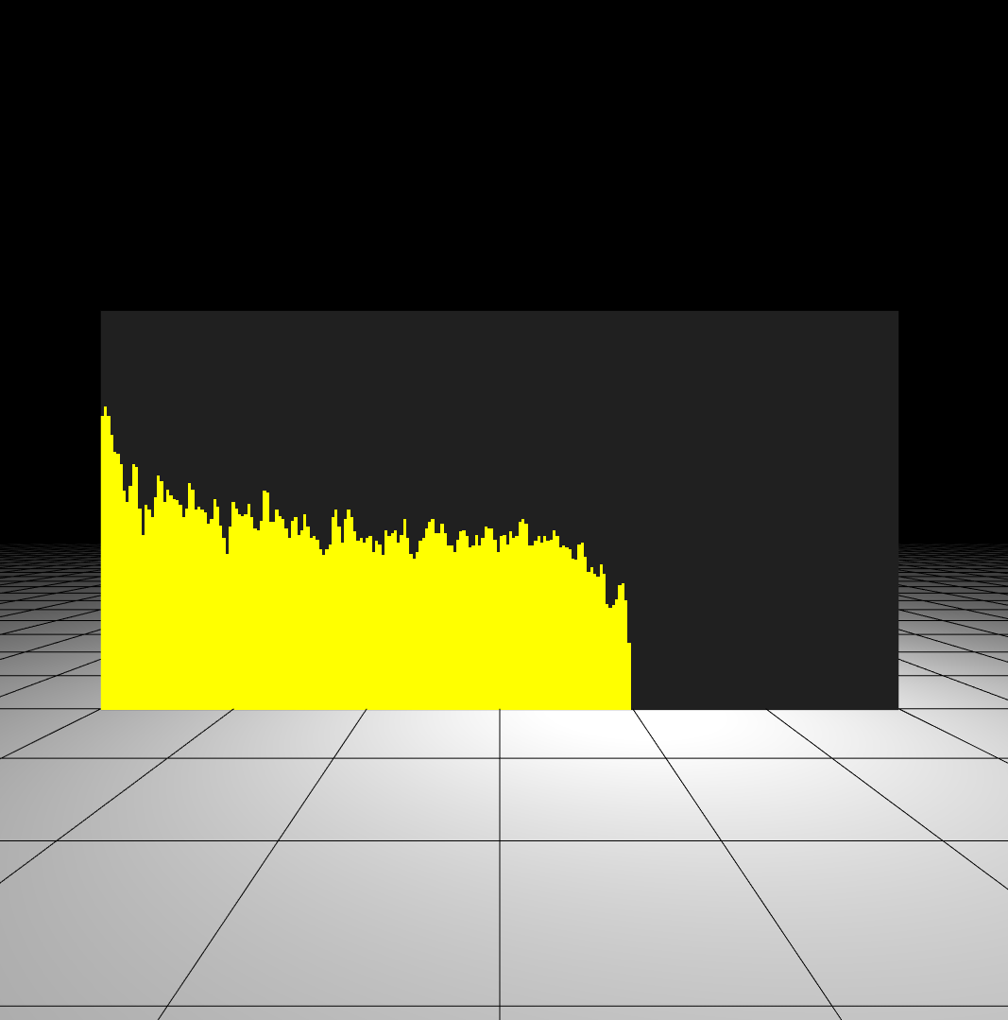
THREE AUDIO VISUALIZER
Overview
Heads-up
This is not a guide, but a sum-up of what I’ve learned.
About the app
Basic Audio Visualizer built with
ThreeJs
WebAudio API
React (react-three-fiber)

Slide 3
THREE AUDIO VISUALIZER
Content
Basic ThreeJS concepts
Introduction & Sample projects
Basic constitution of a ThreeJS scene
Basic WebAudio API concepts used in the project
Fast Fourier Transform
AnalyserNode
General Flow – Process & Display the Audio

Slide 4
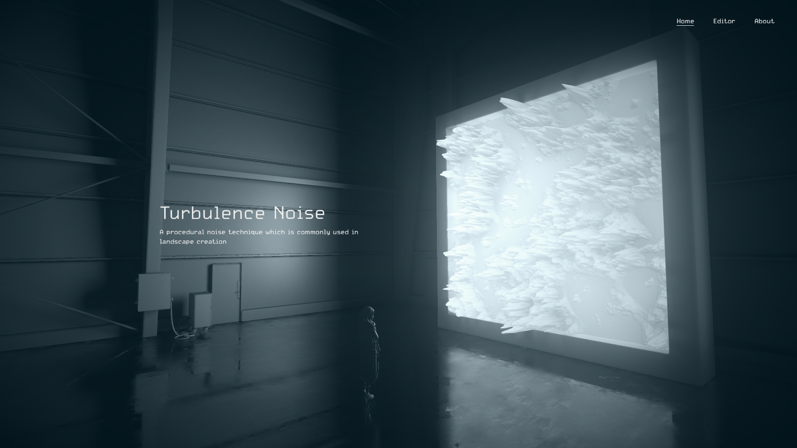

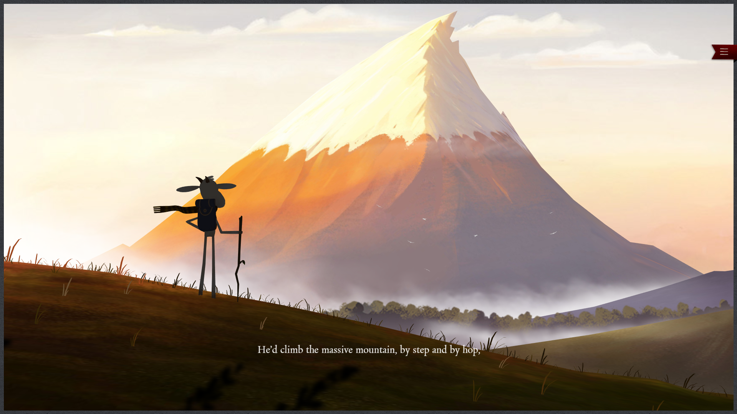
THREEJS
Introduction & Sample Projects
A cross-browser Javascript library and API used to create & display 3D graphics in a web browser.
A wrapper of WebGL, make it easier to use.
Author: Ricardo Cabello (mr.doob)
Initial Release: April 24th, 2010

Slide 5



THREEJS
Basic constitution of a scene
Vertex & Segment
Mesh
Camera
Light
The base building components in ThreeJS
An object created by combining Geometry and Material
Just... Camera.
Sources of light in the scene.

Slide 6
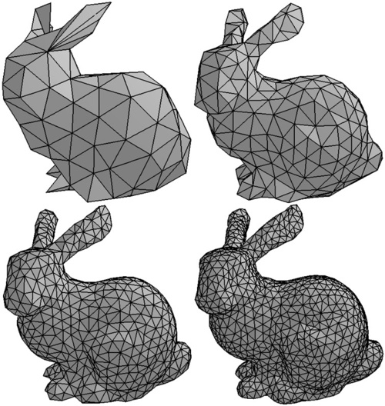

THREEJS
Vertex & Segment
Segment is the base building component in ThreeJS, created with 3 vertices (basically it’s a triangle).
More vertices, more segments -> more details.

Slide 7
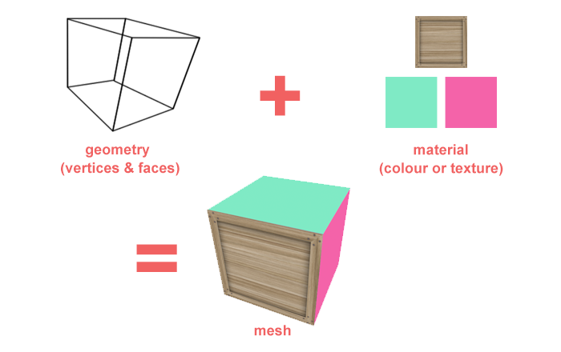
THREEJS
Mesh
An object created by combining geometry and material:
Geometry: A collection of vertices and faces
Material: The material you want the object to be made in
E.g: For a wooden box:
Geometry: Box
Material: Wood

Slide 8
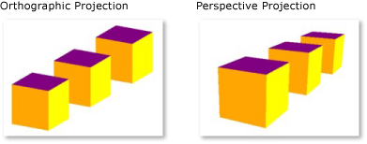
THREEJS
Camera
2 main type of cameras: Perspective and Orthographic
Perspective camera is how we see the real world with depth. We can judge the distance.
Orthographic camera remove that perspective (think of a 2D, side-scrolling game such as Mario).

Slide 9

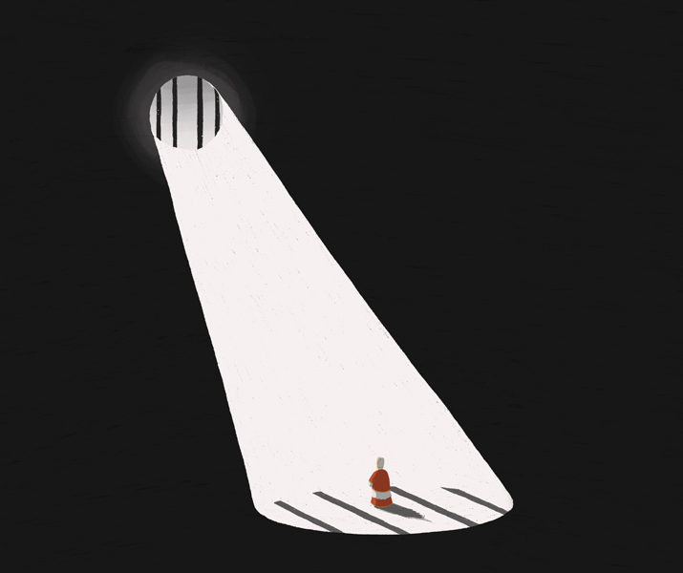

THREEJS
Light
ThreeJS provides objects acting as different types of light source:
SpotLight
PointLight
AmbientLight
...
Please refer to the examples for better illustrations.

Slide 10
THREEJS
Basic constitution of a scene
Vertex & Segment
Mesh
Camera
Light
The base building components in ThreeJS
An object created by combining Geometry and Material
Just... Camera.
Sources of light in the scene.

Slide 11
AUDIO ANALYSING
WebAudio API
"The WebAudio PI provides a powerful and versatile system for controlling audio on the Web, allowing developers to choose audio sources, add effects to audio, create audio visualizations, apply spatial effects (such as panning) and much more.“
Things I’ll go into:
Fast Fourier Transform (FFT)
AnalyserNode from the WebAudio API

Slide 12
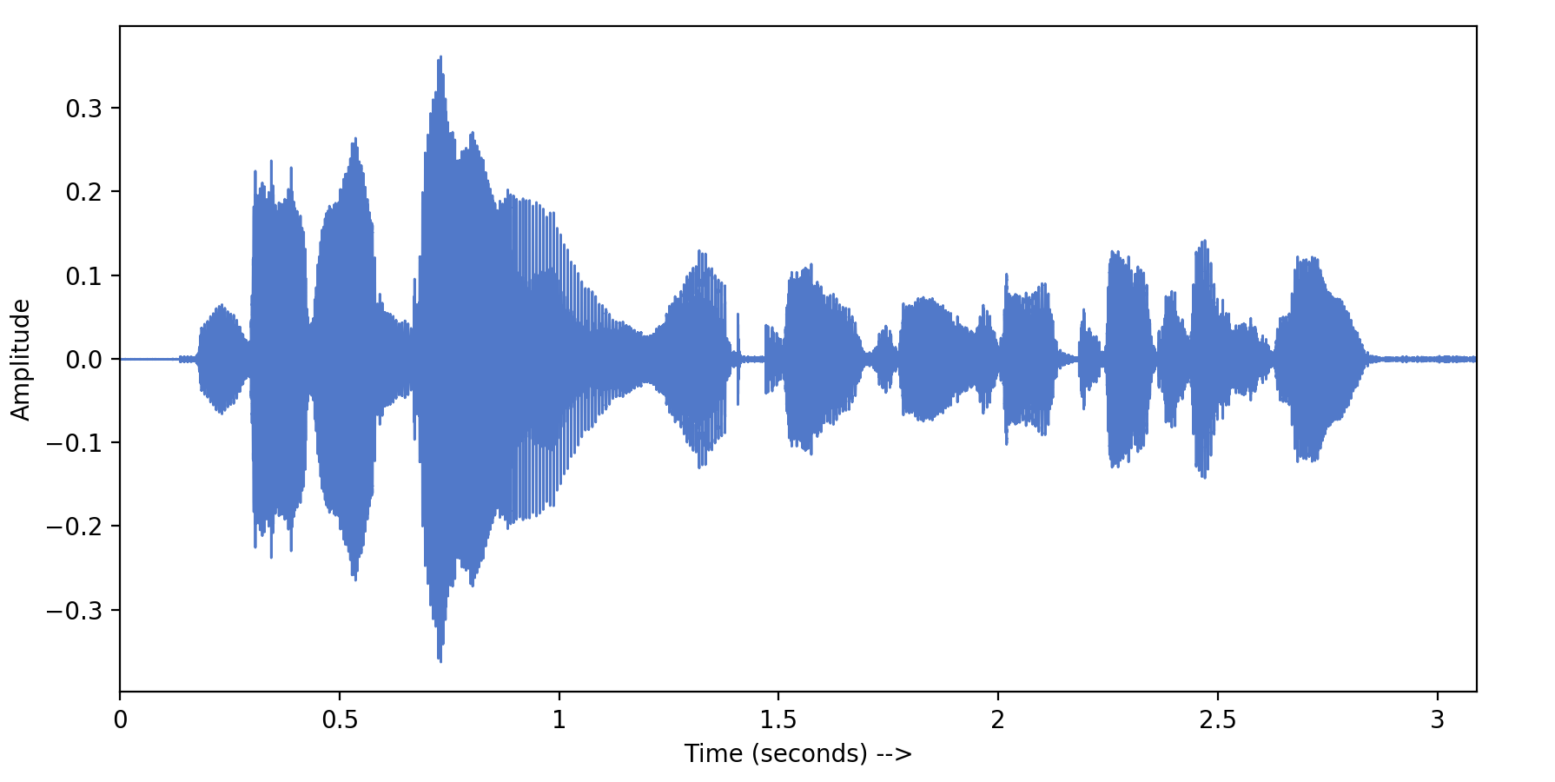
AUDIO ANALYSING
Fast Fourier Transform

Slide 13
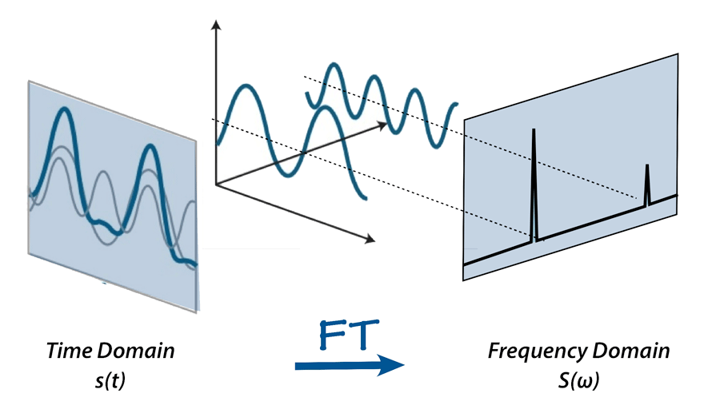
AUDIO ANALYSING
Fast Fourier Transform
ELI5: Fast Fourier Transform is like a recipe finder.

Slide 14
AUDIO ANALYSING
AnalyserNode
We’ll use getFloatFrequencyData() method, which uses FFT under the hood to determine the frequency domain.
The returned value is a normalized array of values between 0 and 255, representing the power value (amplitude) of the sound at each calculated frequency.
For example:
1000Hz: 255 (loud),
2000Hz: 196 (less loud),
3000Hz: 40 (less less loud),
4000Hz: 0 (silent at this frequency),
...

Slide 15
GENERAL FLOW
Processing & Display
Input a sample audio file
Use the WebAudio API & Fast Fourier Transform (FFT) to convert the audio soundwave into frequency-domain data
Base on the data, render the shapes to visualize it with three.js

Slide 16
TechRadar
Q&A
May 17th, 2020

